Slide 1
OPEN TO CHANGE
Open Group Substance Abuse Curriculum

Slide 2
OPEN TO CHANGE - 30
State-of-the-art substance abuse programming shaped for flexible administration - and concrete results.
Comprehensive 30-session, open group program package featuring a creative new approach: participants can be added to the group at any point, but the outcome-driven model provides structure and support for individual progress and change.

Slide 3
OPEN TO CHANGE - 30
Easy to implement, turnkey model includes complete resources for 30 group sessions, one-on-one counseling, and support in documenting participation, progress, and outcomes.
Based on our widely-used New Freedom and Insight and Outlook substance abuse program models, including the documented and successful A Road Not Taken program at New York City’s Rikers Island.

Slide 4

In the year following introduction of A Road Not Taken, drug court judges began to note that inmates who completed the program were not being re-arrested as frequently as those who did not receive the programming. As a result, the program was officially partnered with the drug courts, and judges began sentencing offenders directly into the program.

Slide 5
In October of 2012, research data from A Road Not Taken was selected to be presented at the American Public Health Association 140th Annual Meeting and Expo in San Francisco. Among the findings:
41.67% reduction in multiple re-arrests
23% reduction - to 32% - of recidivism for those experiencing a longer length of stay (more than 41 days) in the program.

Slide 6
Riker’s Island facility in NYC uses our materials in two programs: A Road Not Taken (substance abuse) and Beyond The Bridge (mental health):
A Road Not Taken has documented a 35% decrease in recidivism. Judges in NYC are sentencing offenders directly to the program.
Beyond the Bridge 31% drop in violent incidents across the population using our curriculum, as opposed to a 15% drop in violent incidents across the entire facility

Slide 7
OPEN TO CHANGE
This resource is CBT and MI-based, and specifically addresses the most common and problematic issues underlying pre-contemplation in this population!
Core program elements address internal and external risk factors for past problems and guide the development of effective relapse prevention plans. The materials guide participants from pre-contemplation through subsequent stages of change.

Slide 8
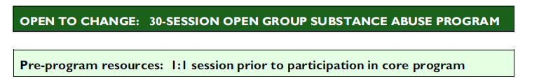
The program begins with a 1-on-1 session prior to participation in the program. Resources include assessment worksheets and resources to start to chip away at pre- or anti-contemplation.
OPEN TO CHANGE
Notes:
the New Hampshire Youth Development Center (sole state facility), as well as NH mens’ and womens’ prisons
all nine juvenile detention centers in West Virginia
every juvenile male correctional facility in Alaska, Wyoming, and Wisconsin
every juvenile justice commission facility and program statewide, and every county juvenile detention facility in New Jersey
8 residential facilities in Northern Florida
all residential facilities of the Ohio Department of Youth Services
the New Hampshire Youth Development Center (sole state facility), as well as NH mens’ and womens’ prisons
all nine juvenile detention centers in West Virginia
every juvenile male correctional facility in Alaska, Wyoming, and Wisconsin
every juvenile justice commission facility and program statewide, and every county juvenile detention facility in New Jersey
8 residential facilities in Northern Florida
all residential facilities of the Ohio Department of Youth Services

Slide 9
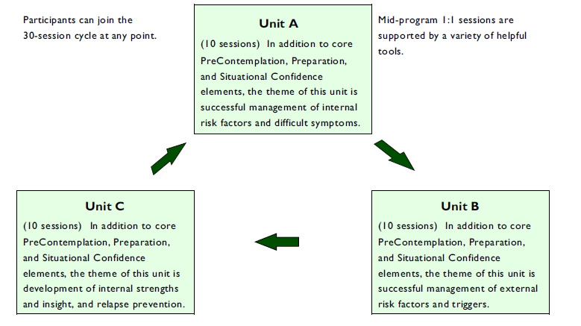
The 30-session model then proceeds to three 10-session units. The longer (40,50,60 session programs) have similar models.
OPEN TO CHANGE
Notes:
the New Hampshire Youth Development Center (sole state facility), as well as NH mens’ and womens’ prisons
all nine juvenile detention centers in West Virginia
every juvenile male correctional facility in Alaska, Wyoming, and Wisconsin
every juvenile justice commission facility and program statewide, and every county juvenile detention facility in New Jersey
8 residential facilities in Northern Florida
all residential facilities of the Ohio Department of Youth Services
the New Hampshire Youth Development Center (sole state facility), as well as NH mens’ and womens’ prisons
all nine juvenile detention centers in West Virginia
every juvenile male correctional facility in Alaska, Wyoming, and Wisconsin
every juvenile justice commission facility and program statewide, and every county juvenile detention facility in New Jersey
8 residential facilities in Northern Florida
all residential facilities of the Ohio Department of Youth Services

Slide 10
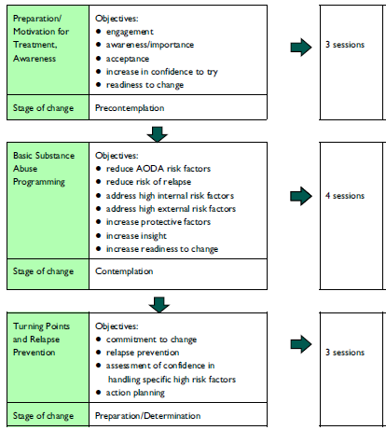
Phoenix/New Freedom Programs
Each one of the three units divides 10 sessions into three subgroups with specific objectives, linked to the stages of change.

Slide 11
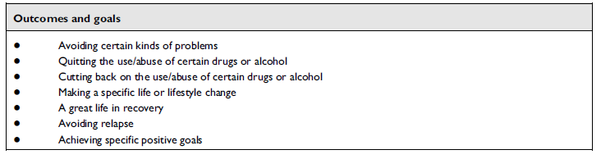
Phoenix/New Freedom Programs
Together, the three units achieve concrete outcomes and goals.

Slide 12
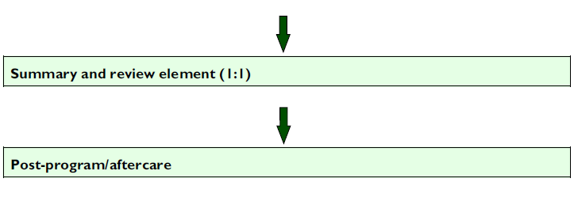
Phoenix/New Freedom Programs
The program concludes with a one-on-one summary and review, and resources to support the progress made within the group.

Slide 13
OPEN TO CHANGE
The program is supported by a wealth of additional resources:
Model program overview-- Visual overview of 30, 40, 50, or 60-session model and intended outcomes.
PCA Change Talk Tool-- Brief assessment of participant motivation (scores reflect stage of change).
MI toolkit -- Includes key resources for assessment of motivation (MI rulers), symptoms management, and development of MI “change talk.” Helpful as an on-desk reference for all program staff. toolkit explanation guides the use of the MI toolkit
(continues on next slide)

Slide 14
OPEN TO CHANGE
MI rulers Importance, Confidence, and Readiness rulers-- Includes all three rulers on one sheet for use in 1:1 sessions.
PEM Progress evaluation model-- Helpful tool for use in 1:1 to assess and document participant progress.
Fidelity monitoring checklist-- Useful checksheet for clinical supervisors and program administrators.
Motivational Interviewing stage-based resource set.-- Multiple resources appropriate for initial assessment, and for participants in the precontemplation stage of change. Also for any participants who have recently relapsed.

Slide 15
OPEN TO CHANGE
This program is remarkably affordable and cost-effective. Provided under our site license allowing for unlimited duplication for all programs conducted at the designated sites or facilities. No future costs.
The full 30-session resource, including all tools, staff support resources, and individual and group materials, is $1995.
The longer programs are priced comparably: 40 sessions- $2625, 50 sessions- $3195, 60 sessions – $3595, etc.

Slide 16
OPEN TO CHANGE
A New Freedom and Insight and Outlook have supported more than 2500 programs nationwide. In addition to this model, we have developed hundreds of different programs: open/closed groups, short/long dosage, adult/ juvenile, male/female gender-specific, dual diagnosis, Spanish-language, correctional, (including in-cell), residential, or community settings.
For more details, a detailed list of the contents of each unit, or to order, please contact:
sabrina@newfreedomprograms.com
(212) 513-0176.

